Slide 1
CHANCE OPERATIONS
Presentation by Abdul Samad Gomda and Ehtisham Ul Haq

Slide 2
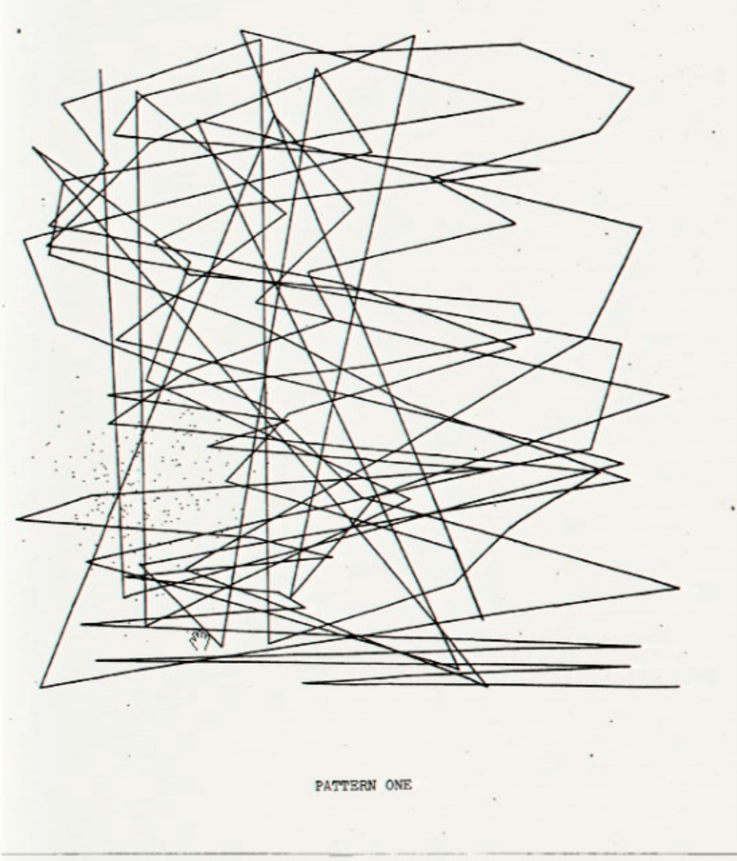
Where do we draw the line between order and chaos?
How would you define perfect order and perfect chaos? Is there a middle-ground?

Slide 3
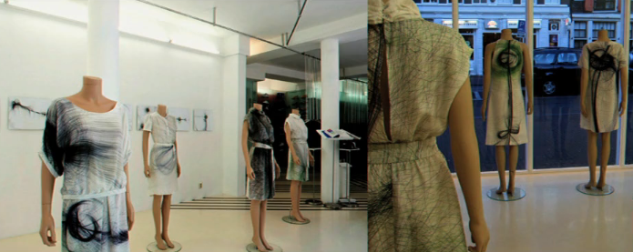
How do we compare random pieces of art?

Slide 4
Chaos Theory thoughts?
Seemingly random, disordered, and irregular systems are governed by underlying patterns.
With this, can there truly be a perfect randomness? Why or Why not? How would you describe perfect randomness?

Slide 5
Should a piece of art always has to mean something to the artist in order to be created?
How did you approach setting up your goal in May 27th and May 31st assignments and was your final product like how it was preconceived in your mind?

Slide 6
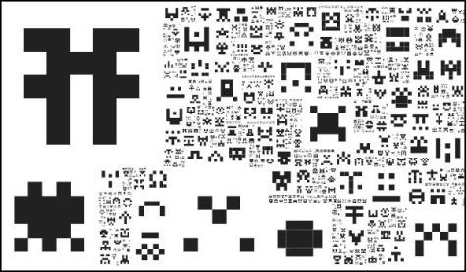
Does setting constraints on random somehow make it less random?
Is there an upper-bound or lower-bound to how random a piece of art should be?
Do you think there are or should be criteria for calling art random? Why or why not?
Thoughts on a system of measurement of the disorder in an artwork, entropy? Pros and cons?

Slide 7
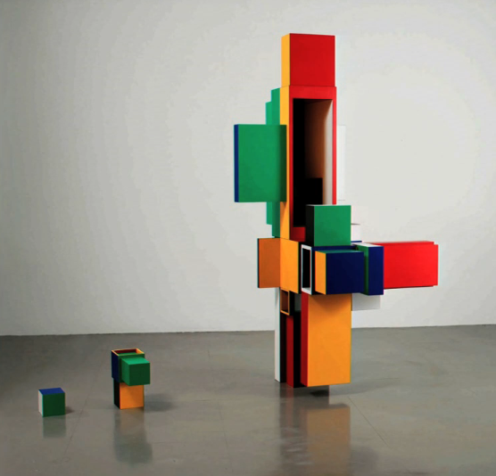
Can one make a piece of art entirely by chance? Or is there always decision-making or ordering involved to at least some extent?
By Keith Tyson

